Slide 1
Introduction to molecular simulations

Slide 2
Molecular simulations are:
Computer calculations that “simulate” or model molecular systems
They are run by codes or computer programs
We tell computers about the physics
set up the calculation
And let the computer tell us about the behavior
The results are as good as the physics that describe them
The “molecular” systems can be:
Molecules (including polymers, enzymes, …)
Atoms
Solid state materials
Liquids
Etc…

Slide 3
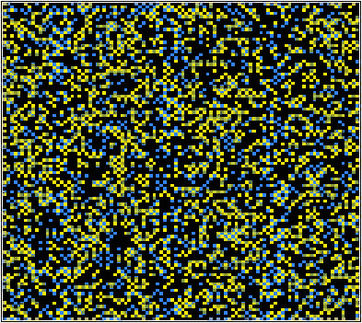
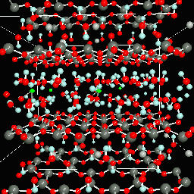
Statistical and deterministic simulations
Statistical simulations
Monte Carlo simulations use random numbers to sample a distribution and compute properties
Tend to be discrete
Deterministic simulations
Molecular dynamics calculates the trajectory of all the atoms based on Newton’s laws
Tend to be continuous

Slide 4
Other classes of simulations
Empirical
The physics are modeled by equations that are known to work for some situations, but the equations have no physical meaning
Fick’s law of diffusion
Semi-empirical
The physics are modeled using equations that are physics based, but fitted to give results consistent with experiments
Ab initio or First Principles
The physics are described by equations derived exclusively from physical insight, with no fitted or adjustable parameters
Density functional theory
Quantum chemical calculations

Slide 5
What can be calculated?
Materials properties
Forces, stresses, pressure
Lattice constant, bulk modulus, density
Reaction energies, barriers
Vibrational frequencies
Dipole moments
Electron densities
Density of states
Any property that can be derived from total energy or electron density, or from changes in those two properties

Slide 6
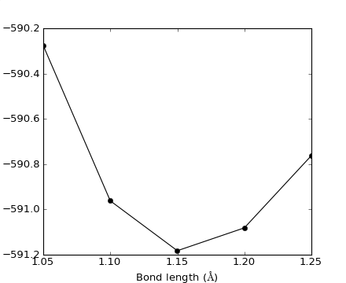
Example 1: Computing equilibrium bond length of CO
Calculate the total energy of a CO molecule at different bond lengths
The lowest energy bond length is the equilibrium bond length
The curvature of the total energy function is related to the vibrational frequency
Total energy (eV)

Slide 7
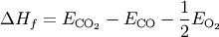
Example 2: Reaction energies formation of CO₂ by CO oxidation
Calculate the total energy of a CO₂, CO and O₂ molecule
Compute the formation energy
Formation energy = -3.24 eV
Experimental value =
-2.94 eV

Slide 8
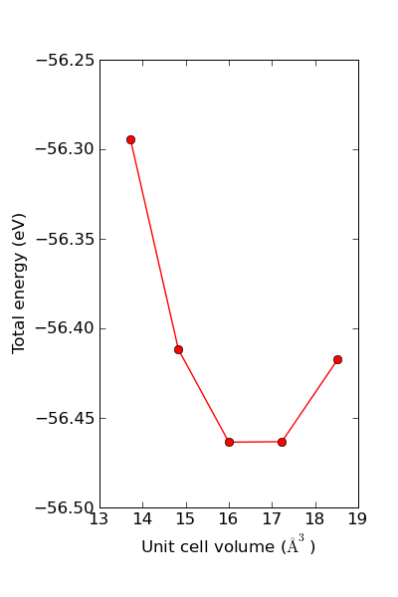
Example 3: Compute bulk lattice constant of Al
Compute the total energy of Al in the fcc crystal structure at different volumes
The lattice constant is at the volume that minimizes the total energy
One would fit an equation of state to the data to identify the minimum

Slide 9
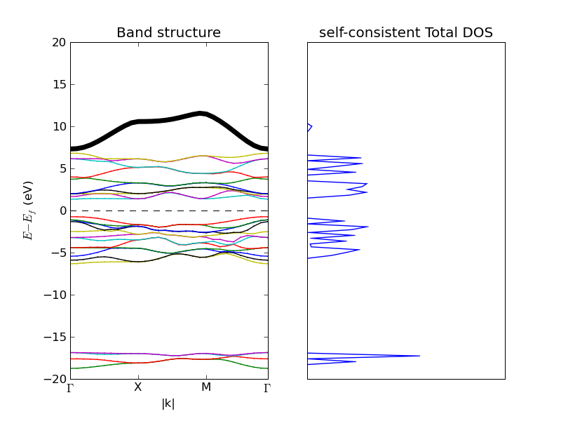
Example 4: Band structure of TiO₂
Band structures and density of states tell you about the energy distribution of the electrons

Slide 10
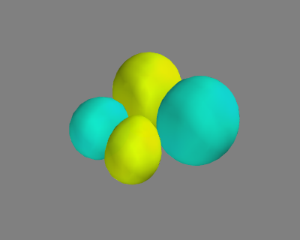
Example 5: Plot a molecular orbital wavefunction
This is the LUMO for carbon monoxide

Slide 11
Quantum mechanics wave-function based simulations
The Hamiltonian contains the physics and is known almost exactly
N-body problem that is impossible to solve analytically except for the smallest atoms H, He
Approximate solutions can be obtained up to about 100 small atoms on state of the art computers
DFT codes like Gaussian use this approach

Slide 12
Density functional theory (DFT) based methods
The total energy is a functional of the electron density
Solve an equation related to the Schrodinger equation
Much simpler equation
Equations are not known exactly, approximations must be made to get them
Can calculate ~1000 atom systems
We will spend most of our time learning about DFT

Slide 13
Tools of the trade
Compiled density functional theory codes
Dacapo, GPAW, VASP, Gaussian, NWChem, …
Scripting environments
Python, ASE
Visualization tools
Matplotlib, mayavi
Database tools

Slide 14
Intro to DFT

